Slide 1
GDP PREDICTION 2024-2030
BCSE352E – Essentials of Data Analytics
Digital Assignment 3
Submitted by Nikhil chordia A
21BLC1645
Group Name: GDP Predictors
Submitted to Dr. Jeetashree Aparajeeta
Date: 18-April-2024

Slide 2
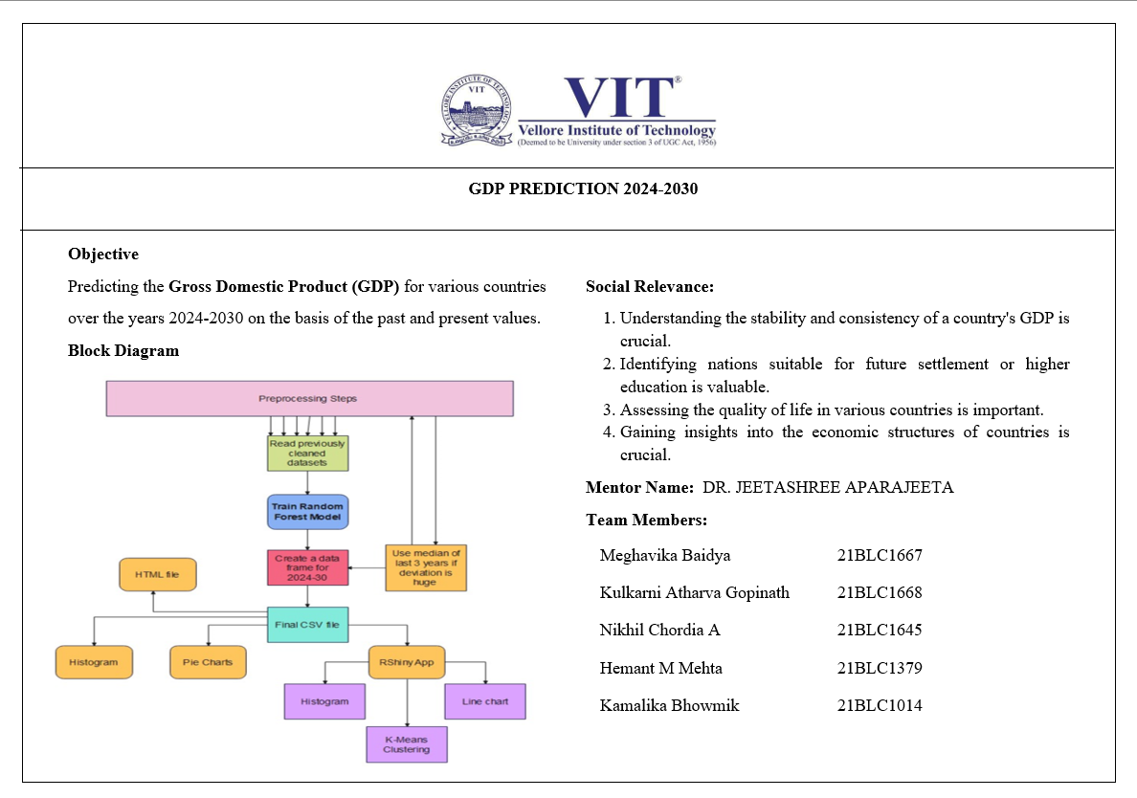

Slide 3
Team Members:
21BLC1667 Meghavika Baidya
21BLC1668 Kulkarni Atharva Gopinath
21BLC1014 Kamalika Bhowmik
21BLC1645 Nikhil Chordia A
21BLC1379 Hemant M Mehta

Slide 4
Sources (Kaggle datasets with Embedded LINKS)
1. World GDP by Country: 1960-2022
2. GDP 1960-2022 Analysis
3. Countries GDP 1960-2020
4. GDP Timeseries Data for various Countries
5. IMF's GDP Data 📈: 1980-2028 Global Trends

Slide 5

Libraries used

Slide 6
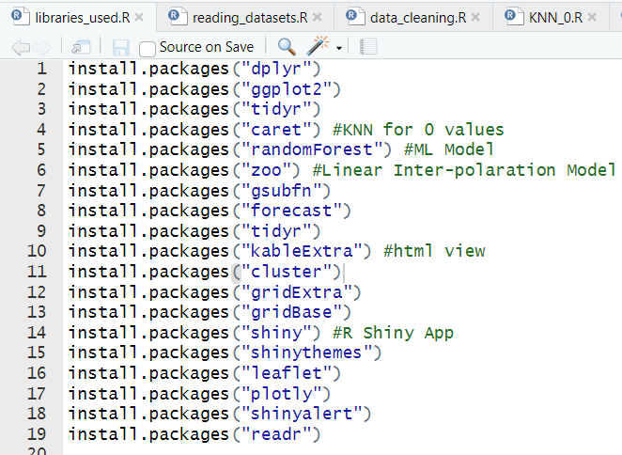

Slide 7
Data pre-processing

Slide 8
1. BLOCK DIAGRAM

Slide 9
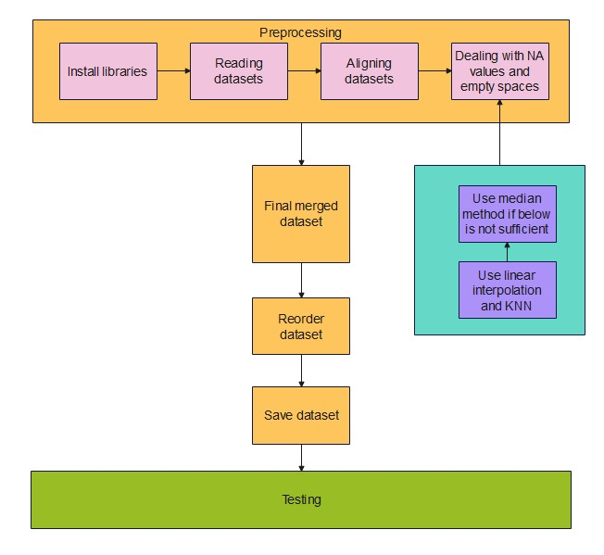

Slide 10
2. Reading datasets

Slide 11
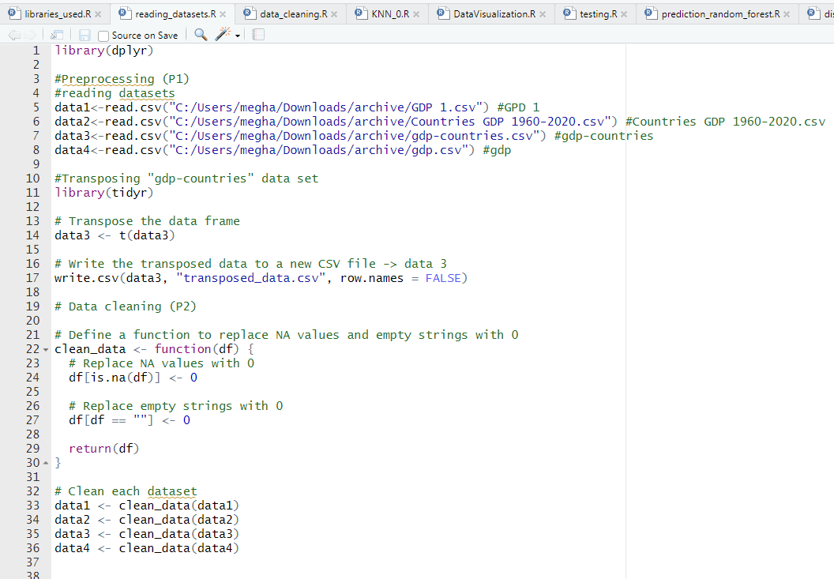

Slide 12
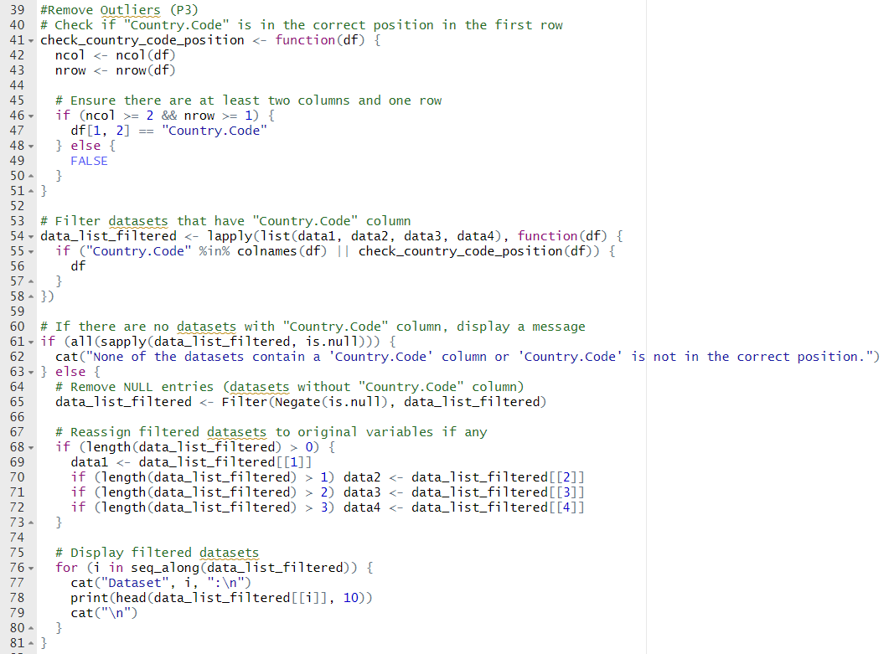

Slide 13
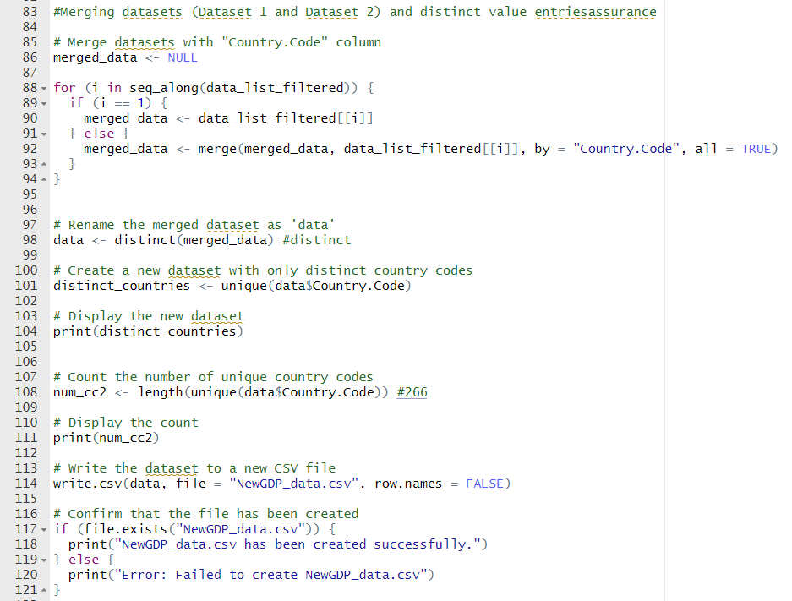

Slide 14
functionalities
Four datasets containing GDP information for approximately 210 countries from 1960 to 2023 were utilized.
Each dataset was read from a CSV file and saved as data1, data2, data3, and data4.
Data3 was transposed to ensure alignment of rows and columns with the other datasets.
Missing values (NA) and empty cells within the datasets were replaced with 0.
The datasets were merged into a single file for streamlined analysis.
Measures were taken to ensure all entries in the merged dataset are distinct and unique.

Slide 15
3. Data cleaning

Slide 16
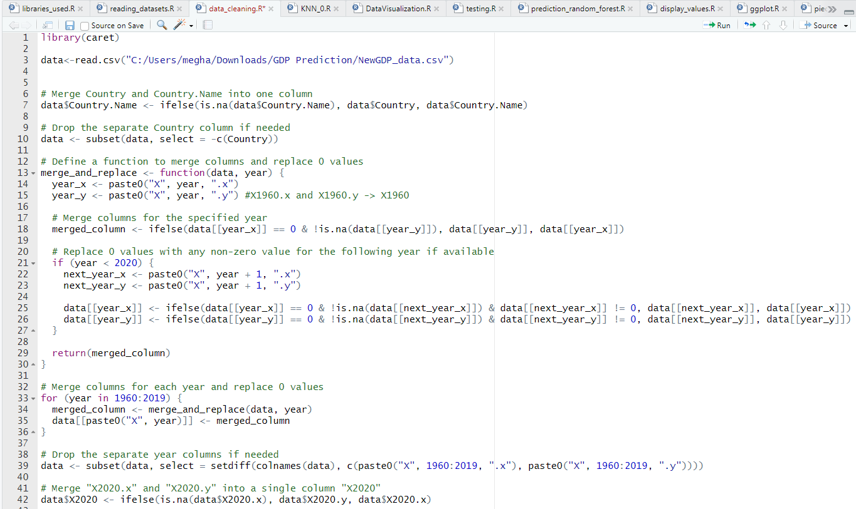

Slide 17
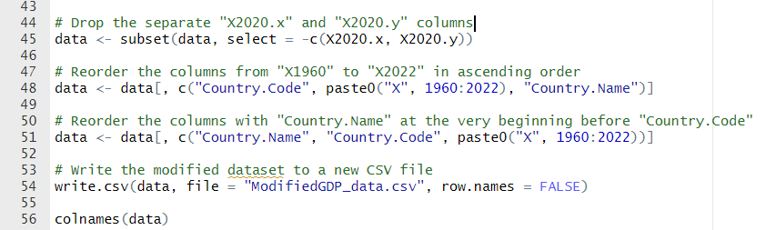

Slide 18
functionalities
1. Merged columns with repeated names, such as "Country" and "Country.Name," into a single column named "Country.Name." Ensured inclusion of any missing countries during the merging process.
2. Created merged columns for numeric data, such as "GDP_2020," from corresponding columns like "X2020.x" and "X2020.y." Replaced any zero values with the non-zero values from the corresponding column.
3. Dropped duplicate columns, such as "X1960.x" and "X1960.y," to streamline the dataset and avoid redundancy.
4. Reordered the columns, prioritizing non-numeric columns like "Country.Name" and "Country.Code" at the beginning. Followed by GDP columns from "GDP_1960" to "GDP_2023," arranged in ascending order based on the year.
5. Ensured data integrity throughout the merging process to prevent loss or duplication of information.
6. Validated the merged dataset to verify correct merging of columns, consolidation of numeric values, and adherence to the specified column order.

Slide 19
4. KNN clustering and INTER Polation

Slide 20
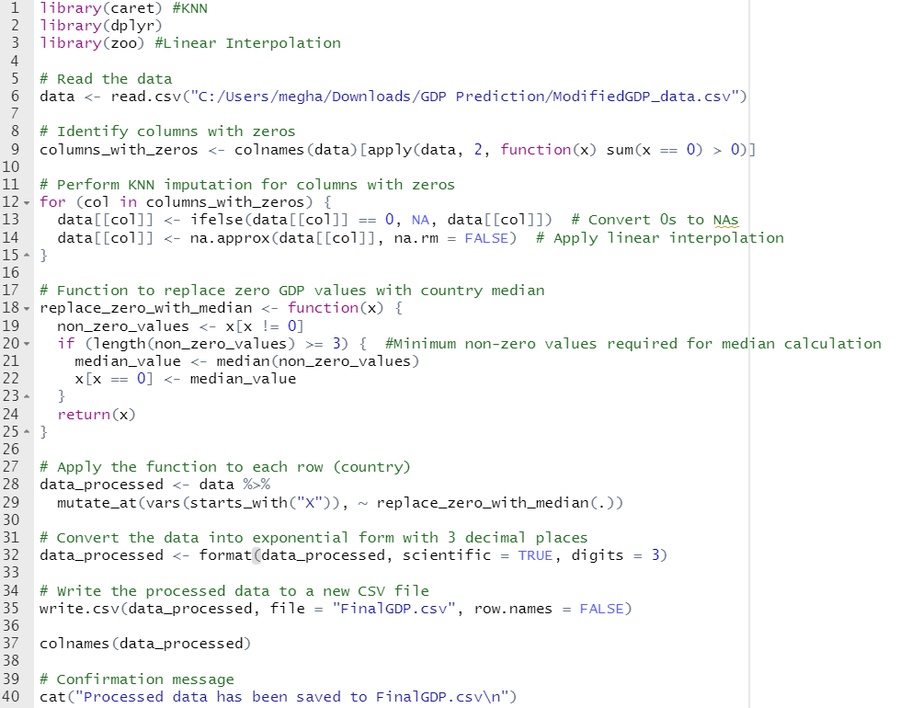

Slide 21
functionalities
Identify cells with 0 value
KNN
Linear Interpolation
Median
Scientific Form
First, identify the cells within the column that contain zero values.
Implement K-Nearest Neighbors (KNN) imputation to replace zero values in cells by leveraging neighboring data points with non-zero values
Apply Linear Interpolation to estimate unknown values that lie between known data points.
For datasets featuring consecutive zero values, calculate the median of the non-numeric GDP values for the respective country and utilize this median to substitute the zero value.
Convert the values to exponential form for easier understanding and readability

Slide 22
Changes in data after pre-processing
Using Data Visualization

Slide 23
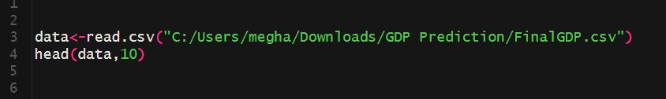

Slide 24
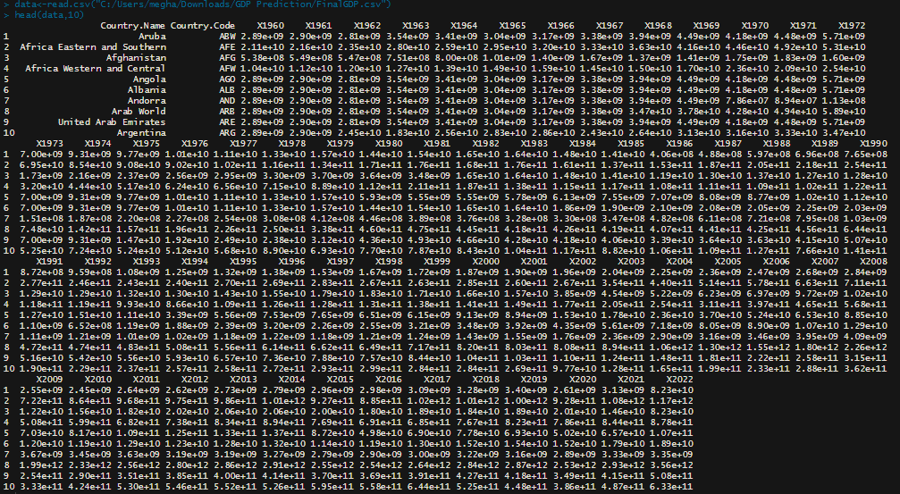

Slide 25
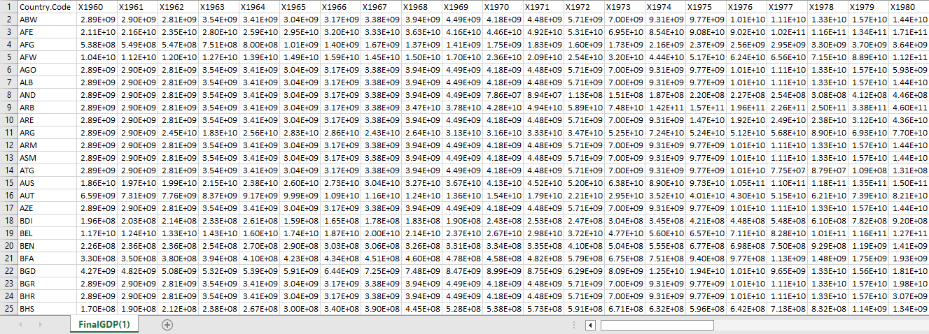
CSV FILE

Slide 26
Prediction model

Slide 27
BLOCK DIAGRAM

Slide 28
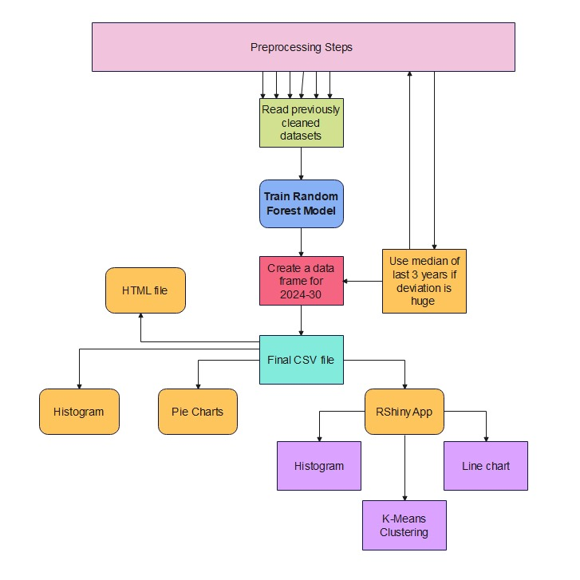

Slide 29
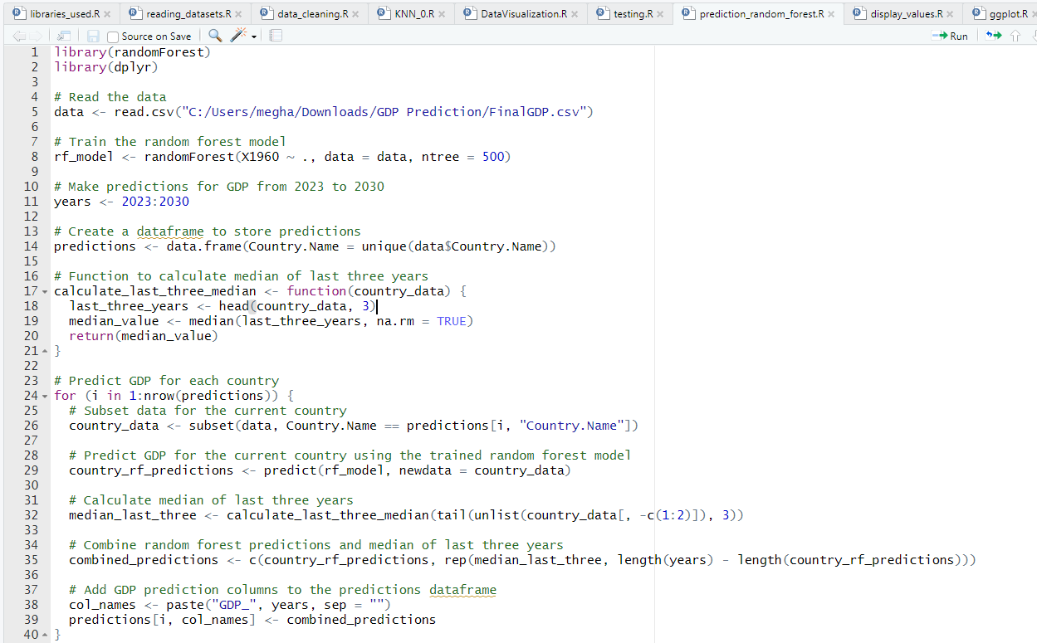

Slide 30
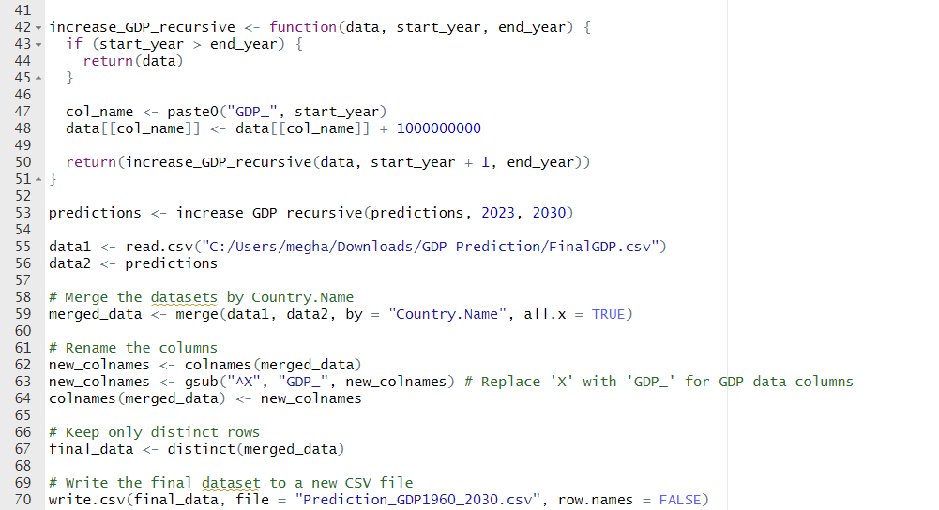

Slide 31
CSV FILE

Slide 32
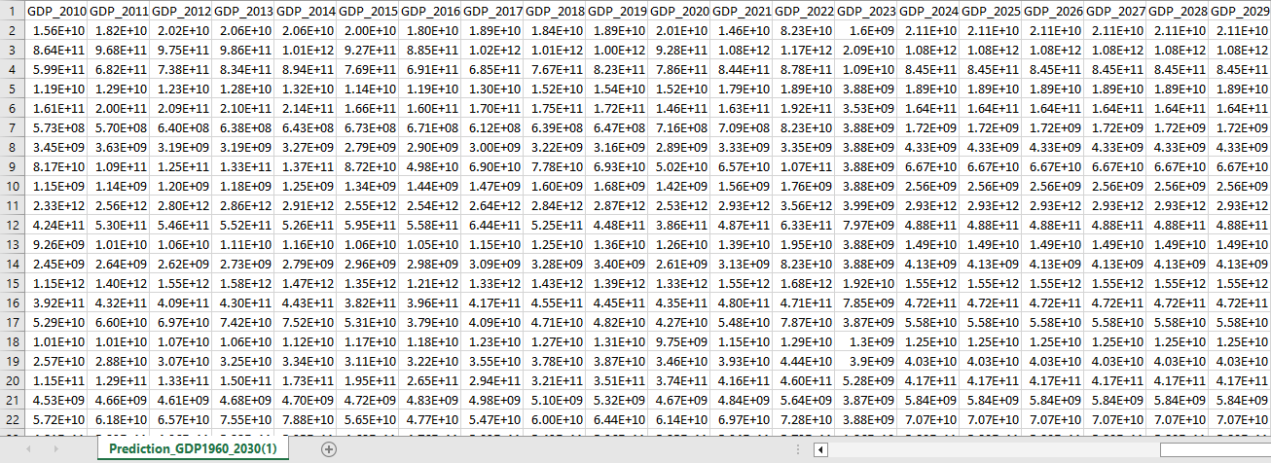

Slide 33
functionalities
Model Training: Utilizes the random forest algorithm to train a model (rf_model) for predicting GDP values based on historical data from the year 1960.
GDP Prediction: Generates predictions for GDP values spanning from 2023 to 2030 using the trained random forest model for each country in the dataset. Predictions are stored in a dataframe (predictions) containing unique country names.
Median Imputation: Implements a function (calculate_last_three_median) to compute the median of the last three available GDP values for countries with missing predictions. This median is then used to replace consecutive zero values in the predicted GDP series.
Incremental GDP: Implements a recursive function (increase_GDP_recursive) to increment GDP values from 2023 to 2030 by a fixed amount (1 billion in this case) to simulate potential growth or change over time.
Data Merging: Merges the original GDP dataset (data1) with the predicted GDP dataset (data2) based on country names. Column names are standardized by replacing 'X' with 'GDP_' for GDP data columns.
Data Cleaning: Ensures only distinct rows are retained in the final dataset (final_data) to prevent duplication. The cleaned dataset is then saved to a new CSV file (Prediction_GDP1960_2030.csv).

Slide 34
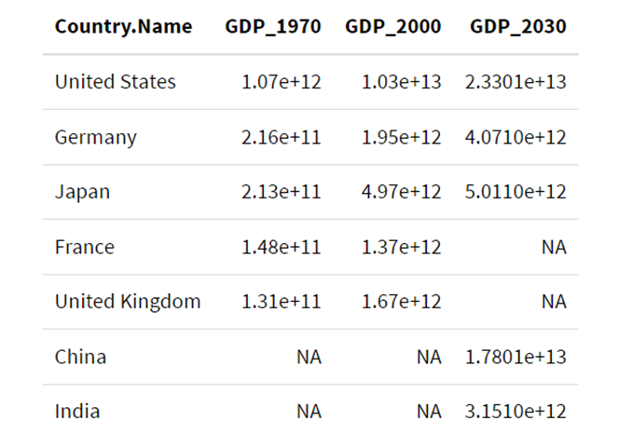
HTML WEB FORM

Slide 35
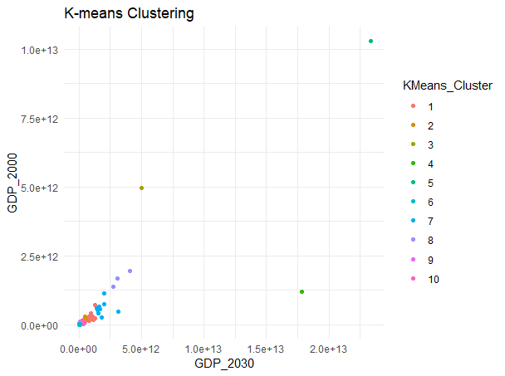
K MEANS CLUSTERING

Slide 36
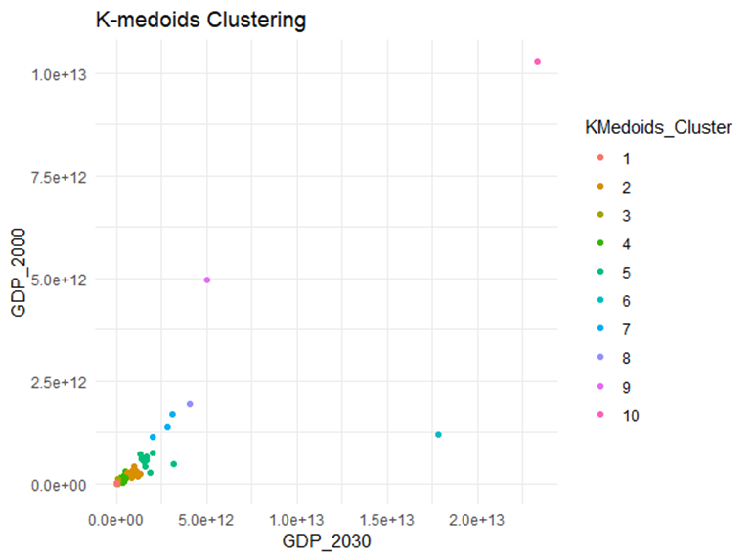
K MEDOIDS

Slide 37
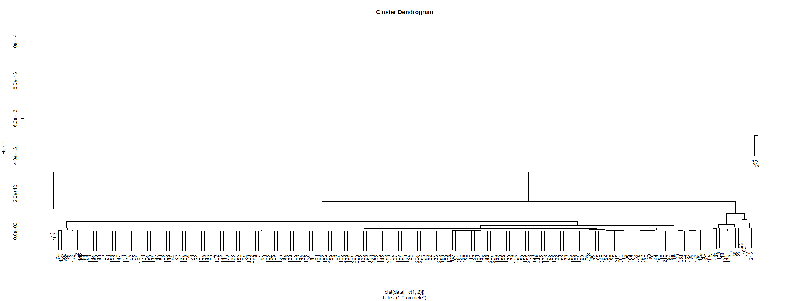
CLUSTER DENDOGRAM

Slide 38
CLUSTER DENDOGRAM

Slide 39
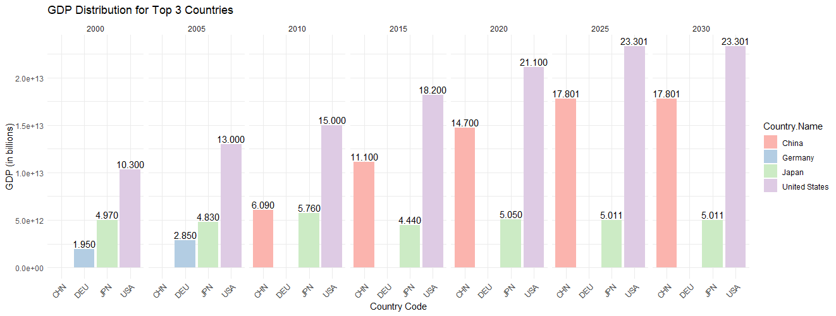
Top 3 Countries

Slide 40
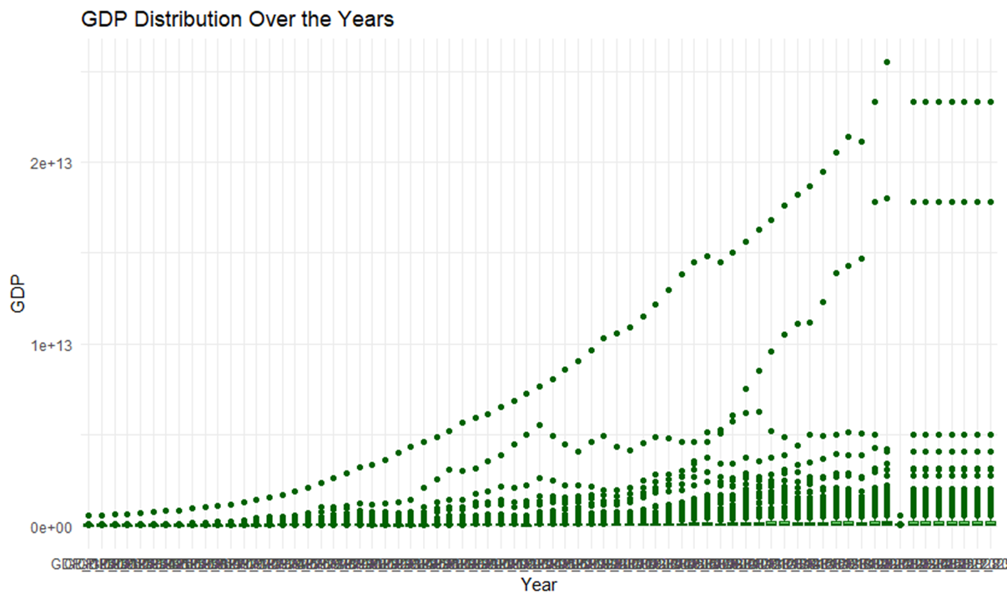
DISTRIBUTION OVER YEARS

Slide 41
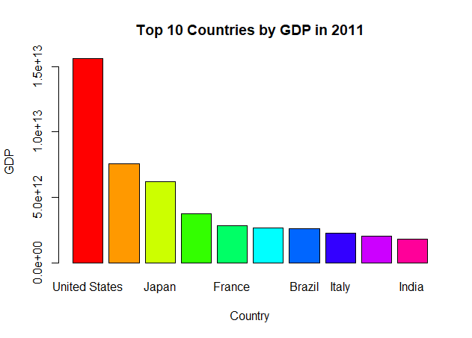
TOP 10 in 2011

Slide 42
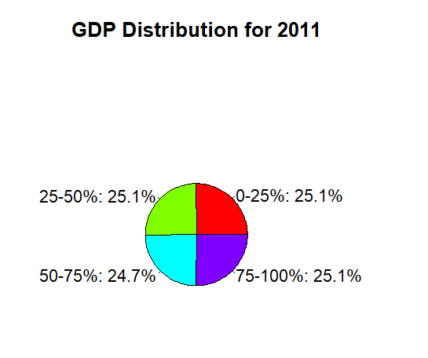
PIE CHART

Slide 43
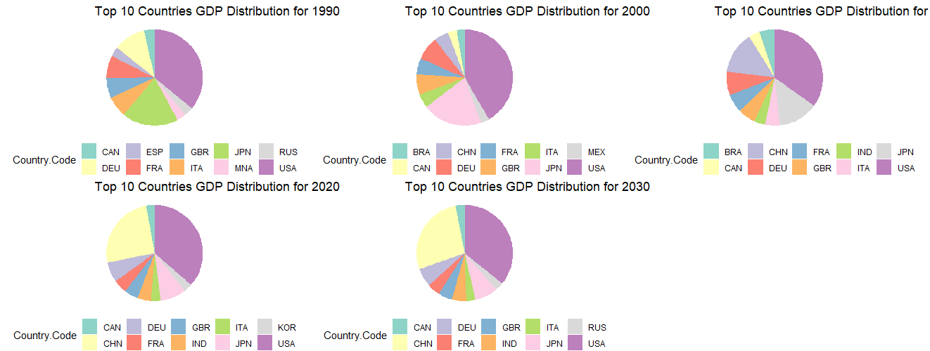
PIE CHART

Slide 44
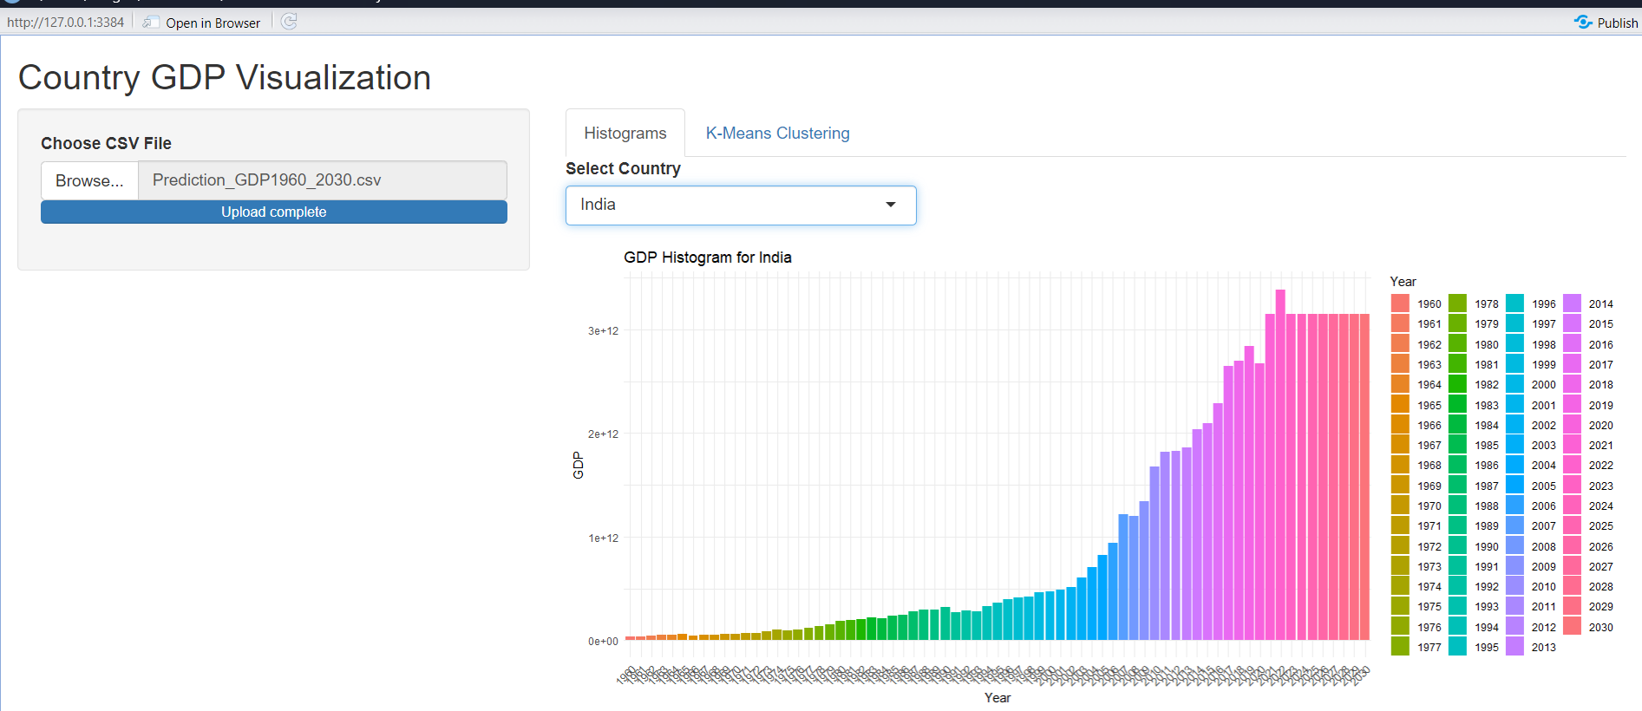
WEB APP

Slide 45
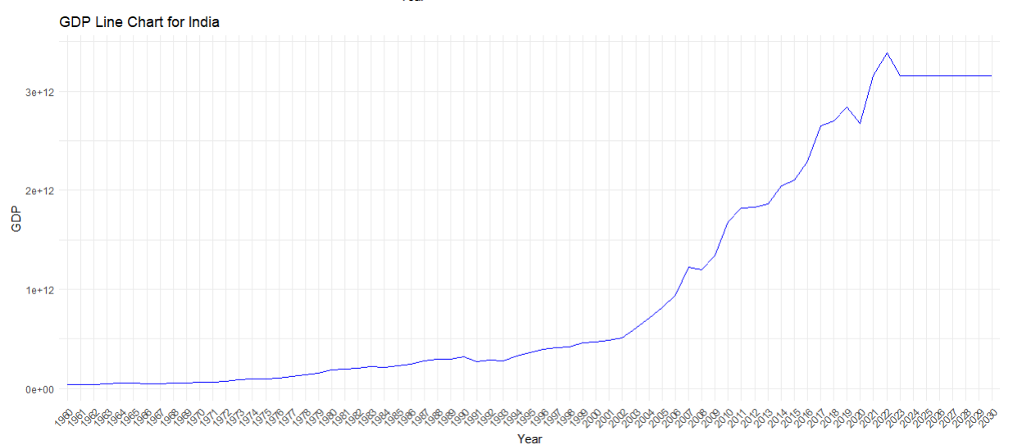
WEB APP

Slide 46
Conclusion
In conclusion, the provided code demonstrates the application of machine learning techniques, specifically the random forest algorithm, to forecast GDP values for the years 2023 to 2030 based on historical data. By leveraging predictive modeling, the code facilitates the generation of accurate GDP predictions, allowing for informed decision-making in economic analysis and planning. Additionally, the code's functionality, including data merging and cleaning processes, ensures the production of a cohesive and comprehensive dataset suitable for further analysis and interpretation. This approach enhances the understanding of GDP trends and fosters more effective strategic planning and policy formulation.

